Slide 1
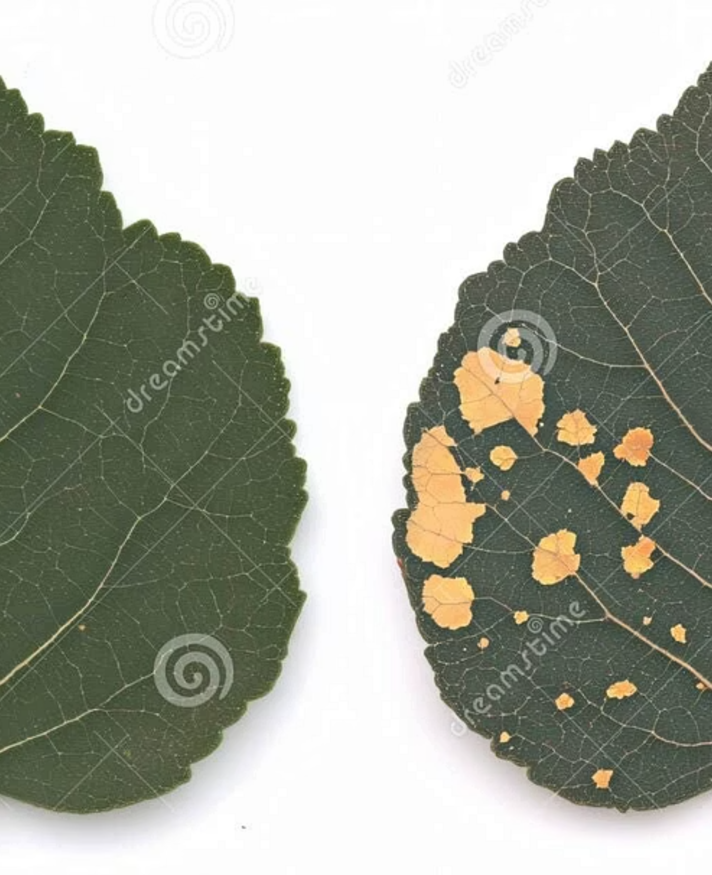
Development of a Mobile App for Automated Plant‑Disease Detection and Severity Estimation
Kirill Klimenko — Novosibirsk State Technical University, Russia
Research adviser: Alexander Fedorovich Aleynikov
Language adviser: Anna Aleksandrovna Khvostenko

Slide 2
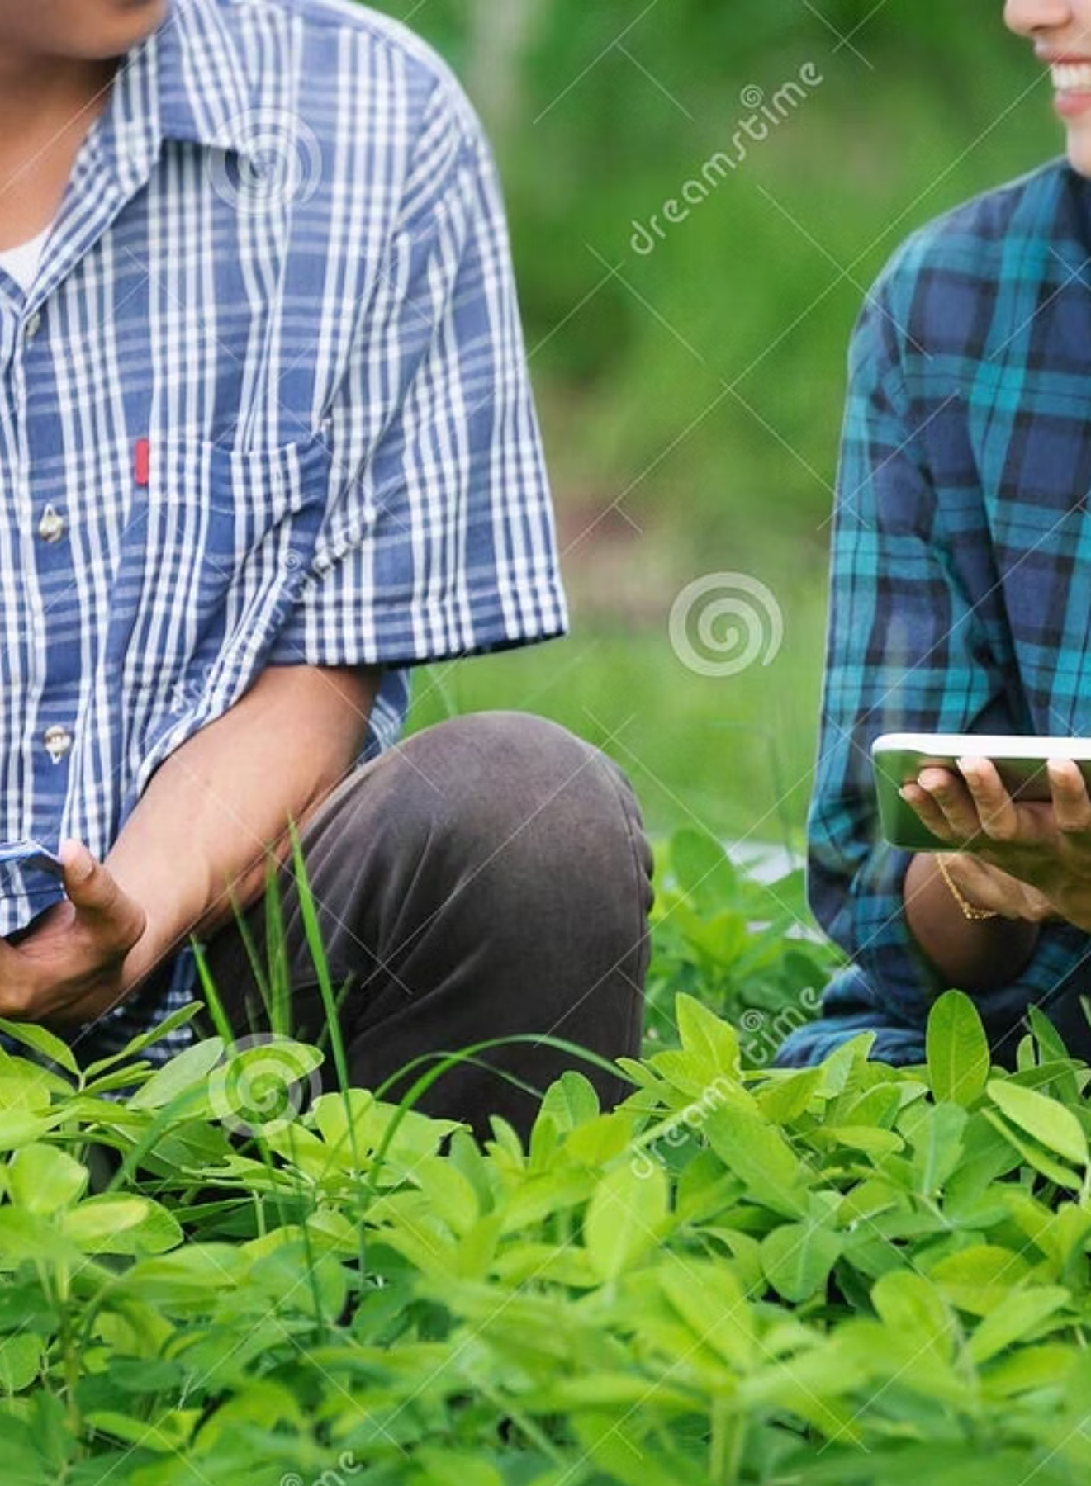
Problem Statement & Motivation
Crop yield losses exceed 50% in some regions due to pests and diseases. Rural areas suffer from limited access to expert agronomists and timely diagnostics. Existing mobile tools often fail in realistic field conditions — noised backgrounds, variable lighting, and inconsistent capture angles — and rarely quantify disease severity.
Key challenges
Project objective
Scarcity of expert agronomists in rural settings
Poor model generalisation in-field (noise, light)
Lack of reliable severity quantification
Create an offline-capable mobile app for real‑time diagnosis and pixel‑accurate severity estimation to support precise treatment decisions.

Slide 3
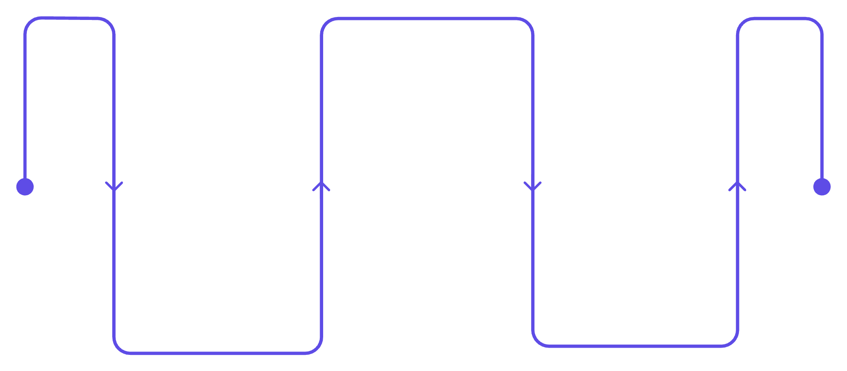
Proposed Methodology — Three‑Stage Pipeline
Pipeline decomposes the task into: robust leaf localisation, crop-specific binary detection, and pixel-wise severity estimation. This hierarchical design reduces noise and improves quantification.
Binary Classification & Categorical Classification
Crop-specific healthy vs diseased & disease classification
Leaf Segmentation
Severity Estimation
Isolate leaf from background
Pixel mask to percent affected
Each stage is optimised for lightweight on-device inference while preserving accuracy in realistic field conditions.

Slide 4
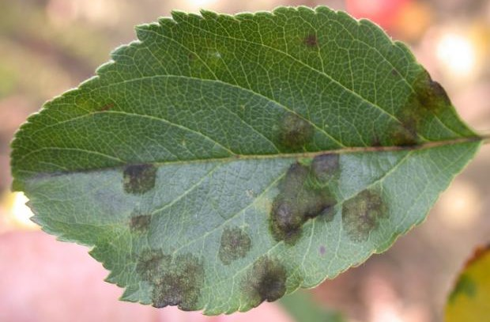
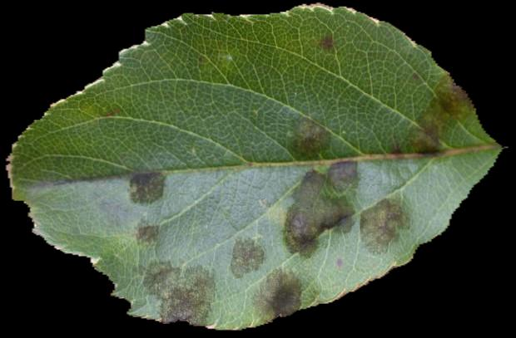
Stage 1 — Leaf Segmentation
Backbone: MobileNetV3Large. Goal: accurately isolate leaf pixels from complex backgrounds to reduce false positives in downstream steps. Pre-segmentation improves robustness to shadows, soil, and adjacent leaves.
Design choices
Lightweight encoder for mobile deployment
Training with diverse background augmentation
Post‑processing: morphological cleaning and contour selection

Slide 5
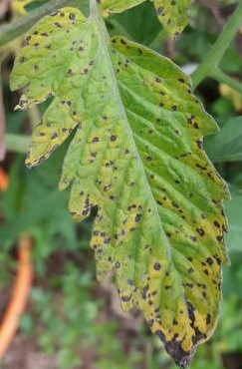
Stage 2 — Binary Classification & Categorical Classification
Approach: separate lightweight classifiers per crop to distinguish Healthy vs Diseased. This specialization reduces label noise from multi-crop variance and improves sensitivity to crop-specific symptoms.
Crops targeted
Apple, Cherry, Corn, Grape, Pepper, Potato, Strawberry, Tomato
Engineering notes
Bacterial Spot
Transfer learning from MobileNet + targeted augmentations (lighting, blur, occlusion)
Continual learning pipeline to get corrected field labels

Slide 6
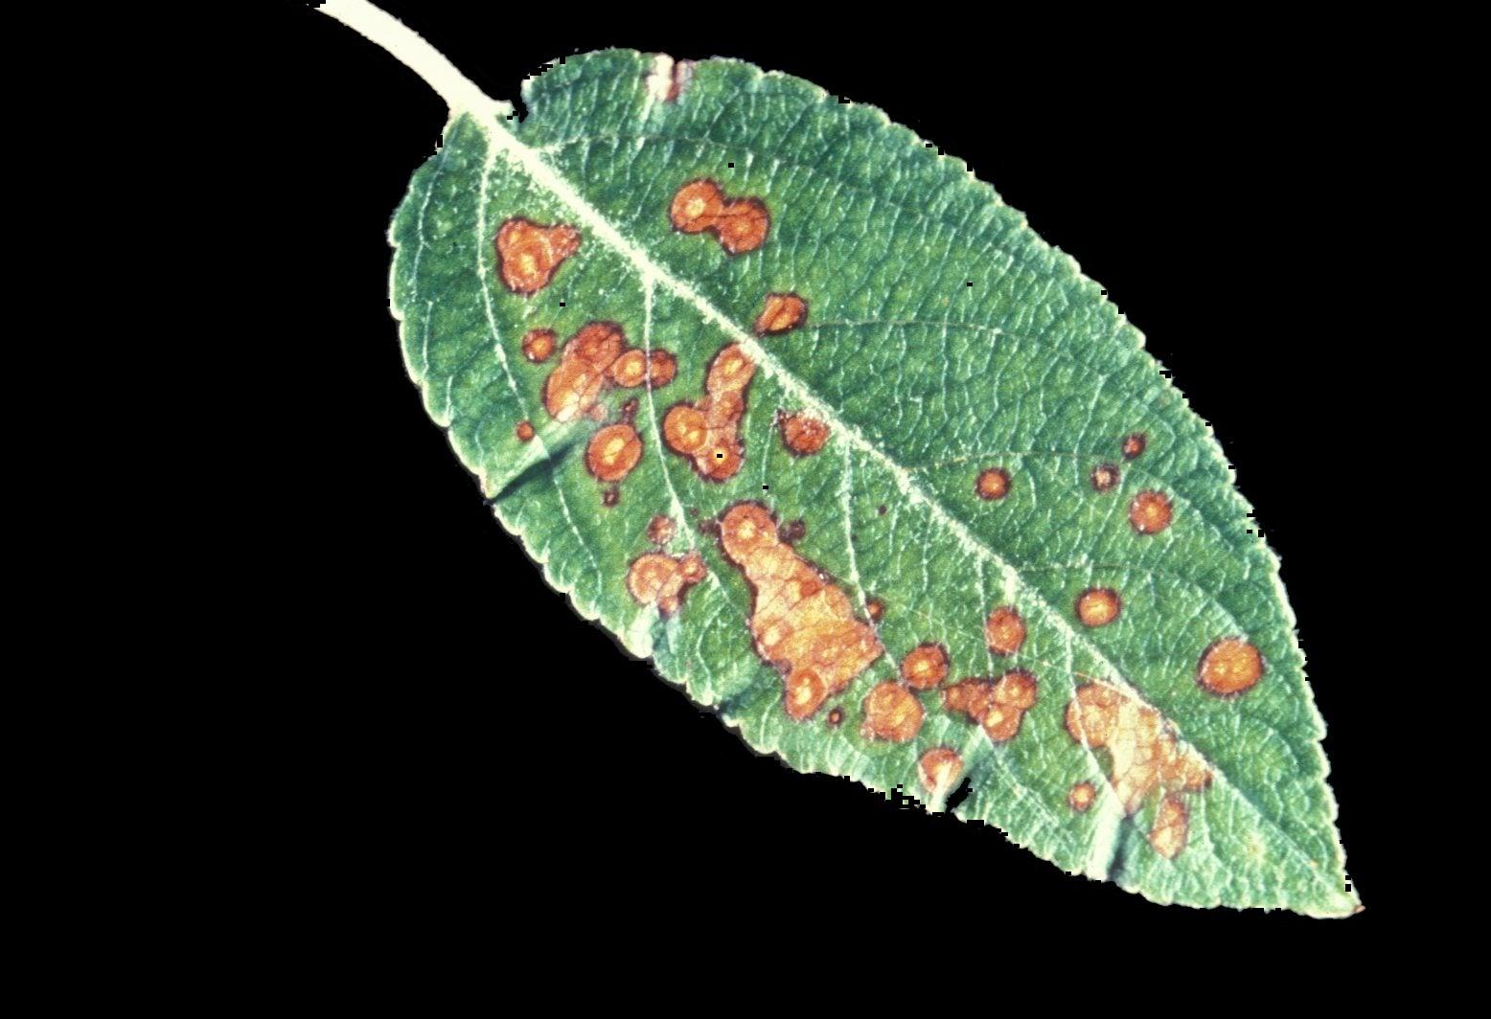

Stage 3 — Severity Estimation
Architecture: U‑Net‑like decoder attached to MobileNetV3 encoder to output pixel-wise disease masks. Severity computed as (pixels_diseased / pixels_leaf) × 100.
Key implementation details
Loss: Intersection over Unit
Output: per-leaf % affected and visual overlay for user verification

Slide 7

Novelty & Implementation
Hierarchical decomposition (localisation → detection → quantification) and modular crop-specific retraining enable scalable, robust mobile diagnosis. Implemented in Python with Keras/TensorFlow and optimized for Android using lightweight backbones.
Practical notes
Offline inference for connectivity-limited regions
Small size of models
Modular updates allow individual crop models to be replaced without app-wide recreating

Slide 8



Performance Targets & Current Status
Performance targets
Current status
Leaf Segmentation IoU ≥ 0.80
Spot Segmentation IoU ≥ 0.70
Binary Classification Accuracy ≥ 0.80 across 8 crops
Categorical Disease Classification Accuracy ≥ 0.80
Inference time < 2s on mid‑tier Android
4 of 8 binary classifiers exceed 0.80 accuracy. Fine‑tuning underway on a curated real‑world dataset (~4,500 images) with corrected masks.
Next steps
Implementation stack: Python, Keras / TensorFlow, MobileNetV3 backbones, Java, Android optimised inference (TFLite) with offline capability.
- Complete mask correction and re‑train segmentation
- Expand crop coverage and severity calibration

Slide 9
Conclusion & Future Work
Modular pipeline substantially increases robustness in field conditions and provides actionable severity estimates to guide targeted interventions. The approach prioritises on-device performance without sacrificing interpretability.
01
02
03
Immediate
Near term
Mid term
Finish fine‑tuning segmentation on corrected masks; expand validation set with field captures.
Add more crop varieties and automate dataset loading from user corrections.
Integrate with drone imagery for monitoring and early warning systems.

Slide 10
References
[1] Bouacida I., et al. Information Processing in Agriculture. 2025. Vol. 12. Iss. 1. P. 54–67.
[2] Mohanty S. P., et al. Frontiers in Plant Science. 2016. Vol. 7. Art. no 1419.
Contact: Kirill Klimenko — Novosibirsk State Technical University. Available on request: dataset metadata, model checkpoints, and deployment scripts.

